Slide 1
Anti-anginal drugs
By okumu peter

Slide 2
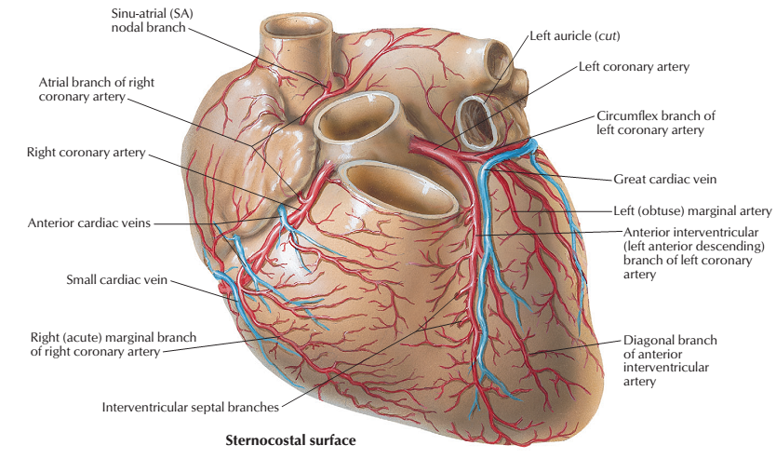
Cardiac anatomy

Slide 3
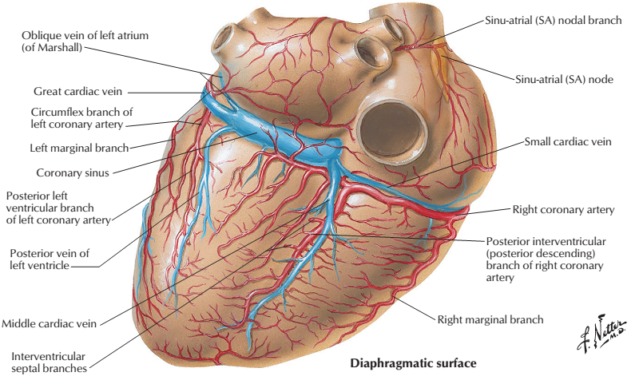
Diaphragmatic surface

Slide 4
Angina
Ischemic heart disease is the most common cardiovascular disease in developed countries
Agina pectoris is the most common condition involving tissue ischemia in which vasodilator drugs are used.
The name denotes chest pain caused by accumulation of metabolites resulting from myocardial ischemia.

Slide 5
PATHOPHYSIOLOGY
the most common cause of angina is atheromatous obstruction of the large coronary vessels.
The primary cause of angina pectoris is an imbalance between the oxygen requirement of the heart
and the oxygen supplied to it via the coronary vessels.

Slide 6
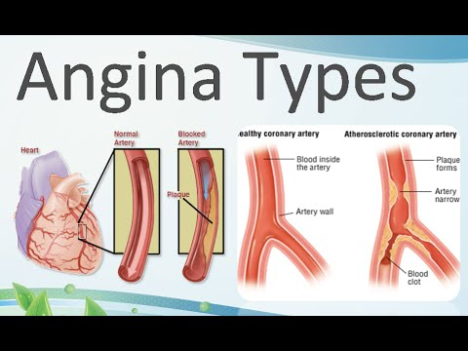
continues
In theory, imbalance between oxygen delivery and myocardial oxygen demand can be corrected by decreasing oxygen demand or by increasing delivery(by increasing coronary flow).

Slide 7
Subtypes of angina
1. Stable / effort-induced / classic / typical angina
Most common imbalance occurs when the myocardial oxygen requirement increases, as during exercise, and coronary blood flow does not increase proportionately
Characteristics: short-lasting burning, heavy, or squeezing feeling in the chest.
Promptly relieved by rest or nitroglycerin
Clinical symptoms
Extreme fatigue,
Nausea
May not be associated with any symptoms (silent angina)

Slide 8
Subtypes of angina
2. Unstable angina
classified between stable angina and MI.
Clinical symptoms
Increased frequency, duration, and intensity of chest pains and can be precipitated by progressively less effort.
Episodes longer than 20 minutes
New-onset angina
Increasing angina
Sudden shortness of breath
Symptoms not relieved by rest or nitroglycerin
Hospital admission and more aggressive therapy to prevent MI and death

Slide 9
Subtypes of angina
3. Prinzmetal / variant / vasospastic/ rest angina
Uncommon pattern of episodic angina
Occurs at rest due to coronary artery spasm
Clinical symptoms
Decreased blood flow to the heart muscle
Attacks not related to physical activity, heart rate or BP
Responds to vasodilators: nitroglycerin and calcium channel blockers
4. Acute coronary syndrome
Disrupted atherosclerotic lesion → platelet activation of the coagulation cascade and vasoconstriction
Intraluminal thrombosis and vascular occlusion
Necrosis of the cardiac muscle may result
Serum biomarker increase e.g., troponins and creatine kinase increase

Slide 10
Angina treatment strategy
Stable angina
β-blockers
calcium channel blockers
organic nitrates
sodium channel–blockers
Agents balance cardiac oxygen supply and demand
Affect BP
Venous return
Heart rate
Heart contractility

Slide 11
β1 receptors blockers
Decrease myocardial oxygen demand (β1 receptors blockade), decrease
Heart rate
Contractility
Cardiac output
BP
Affect both exercise and rest states
Reduce frequency and severity of attacks
Increase exercise duration and tolerance in typical angina.
Recommended as initial antianginal
Ineffective in vasospastic angina → may worsen symptoms
Partial agonists e.g., pindolol should be avoided.
Metoprolol and atenolol, are preferred

Slide 12
Calcium channel blockers
Calcium is essential for muscular contraction. Calcium influx is increased in ischemia because of the membrane depolarization that hypoxia produces.
In turn, this promotes the activity of several ATP-consuming enzymes, thereby depleting energy stores and worsening the ischemia.
The calcium channel blockers protect the tissue by inhibiting the entrance of calcium into cardiac and smooth muscle cells of the coronary and systemic arterial beds.

Slide 13
Calcium channel blockers
All calcium channel blockers are therefore, arteriolar vasodilators that cause a decrease in smooth muscle tone and vascular resistance
These agents primarily affect the resistance of peripheral and coronary arteriolar smooth muscle.
In the treatment of effort-induced angina, calcium channel blockers reduce myocardial oxygen consumption by decreasing vascular resistance, thereby decreasing afterload.

Slide 14
Calcium channel blockers
Their efficacy in vasospastic angina is due to relaxation of the coronary arteries.
Note: Verapamil mainly affects the myocardium, whereas amlodipine exerts a greater effect on smooth muscle in the peripheral vasculature.
Diltiazemis intermediate in its actions. All calcium channel blockers lower blood pressure

Slide 15
Calcium channel blockers
Dihydropyridines
Amlodipine
Arteriolar vasodilator with minimal cardiac conduction effect
Treatment of angina from spontaneous coronary spasm
Nifedipine: usually administered as extended-release oral formulation
Nondihydropyridine
Verapamil
Slows AV conduction decreasing heart rate, contractility, BP, O₂ demand
Contraindicated in depressed cardiac function
Diltiazem
Slows AV conduction, decreases the rate of firing of the sinus node pacemaker, and is also a coronary artery vasodilator.
Relieves coronary artery spasm, useful in variant angina
A/E;includes cardiac arrest, bradycardia, atrioventricular block, and heart failure

Slide 16
organic nitrates
Reduces myocardial O₂ demand relieving symptoms.
Indications: stable, unstable, and variant angina.
MOA
e.g. nitroglycerin dilate large veins, reducing preload (venous return to the heart) and reducing the work of the heart.
Dilate the coronary vasculature, increasing blood supply to the heart muscle

Slide 17
organic nitrates
Nitroglycerin and isosorbide dinitrate, nitroglycerin is prototype.
sublingual route, which avoids the first-pass effect that reduces oral bioavailability typically < 10–20%
Duration of 15-30 mins
Amyl nitrite and related nitrites are highly volatile liquids.
half-lives of only 2–8 minutes given by inhalation.
A/Es; orthostatic hypotension, tachycardia, and throbbing headache.

Slide 18
sodium channel blocker
Ranolazine
Inhibits late phase of Na current improving O₂ supply and demand
Reduces intracellular Na and Ca overload
Improves diastolic function
Antianginal and antiarrhythmic
Indications: chronic angina, prior failed antianginal therapies

Slide 20
Thank for listening any question??
Enjoy

